Slide 1
Assignment 5.2: Circuit Card inquiry lab

Slide 2
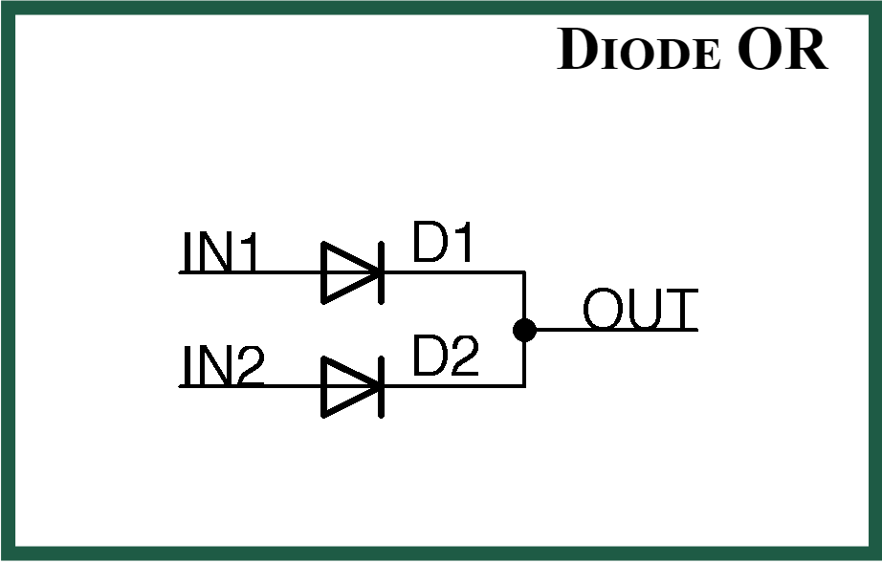
Diode or
A Diode ORing circuit is a method used in power supply systems to combine multiple power sources while preventing back feeding between them. It employs diodes to isolate the sources and ensure that power flows only from the highest voltage source to the load. When one power source fails or drops below a certain threshold, the diodes in the ORing circuit automatically redirect power from the remaining sources to sustain continuous operation. This redundancy enhances system reliability and availability, crucial for mission-critical applications. Additionally, Diode ORing circuits allow for load sharing among power sources, preventing overload on a single source and maximizing power utilization. They are commonly used in various electronic devices, from consumer electronics to industrial equipment, to provide robust and uninterrupted power supply solutions

Slide 3
How diode or circuits are used
Electric Vehicles (EVs): In electric vehicles, diode ORing circuits are employed in battery management systems to manage multiple battery packs efficiently. These circuits help balance charging and discharge among battery cells, optimize energy usage, and enhance the overall performance and reliability of the vehicle.
Uninterruptible Power Supplies (UPS): UPS systems utilize diode ORing circuits to switch between AC mains power and battery backup during power outages or voltage fluctuations. These circuits ensure seamless transition and continuous power supply to connected devices, such as computers, servers, and sensitive electronic equipment.

Slide 4
Advantages
A Diode ORing circuit, commonly used in power supply designs, offers several benefits. Firstly, it enables seamless power source redundancy, crucial for mission-critical systems, by combining multiple input power sources without back feeding. This redundancy enhances system reliability and availability, minimizing downtime due to power failures. Secondly, it provides load sharing among power sources, preventing overload on a single source and ensuring efficient utilization of available power. Moreover, Diode ORing circuits offer low voltage drop characteristics, maximizing power efficiency by minimizing energy losses across the diodes. Additionally, they are simple and cost-effective solutions, requiring minimal components and maintenance. Overall, Diode ORing circuits enhance system robustness, reliability, and efficiency, making them indispensable in various applications requiring dependable power supply solutions.

Slide 5
Disadvantages
While Diode ORing circuits offer numerous advantages, they also come with some limitations. One notable disadvantage is the voltage drop across the diodes, leading to a loss of power efficiency. The forward voltage drop of diodes can result in a reduction of the output voltage available to the load, impacting the overall system performance, especially in low voltage applications. Additionally, Diode ORing circuits may introduce thermal issues due to the power dissipation across the diodes, potentially requiring additional heat sinking or cooling measures. Moreover, these circuits can exhibit limited flexibility in handling varying input voltages or currents, particularly in scenarios where precise control over power distribution is necessary. Furthermore, the voltage drop characteristics of diodes can cause inaccuracies in voltage regulation, affecting the stability of the output voltage. Despite their advantages, these disadvantages should be carefully considered when implementing Diode ORing circuits in power supply designs.

Slide 6
Variations
Several variations of the Diode ORing circuit exist to address specific requirements and challenges in different applications. One variation includes the use of Schottky diodes instead of conventional silicon diodes to reduce the forward voltage drop and minimize power losses, enhancing overall efficiency. Another variation incorporates MOSFETs (Metal-Oxide-Semiconductor Field-Effect Transistors) instead of diodes to further decrease voltage drops and improve power handling capabilities. This MOSFET ORing configuration offers lower on-state resistance and faster switching speeds, ideal for high-frequency applications demanding minimal power loss and heat dissipation. Additionally, advanced ORing circuits may employ active components like integrated circuits or microcontrollers to provide intelligent power management features such as dynamic load balancing, fault detection, and hot-swapping capabilities. These variations cater to diverse needs, offering enhanced performance, efficiency, and flexibility in power supply designs across various industries and applications.

Slide 7
References
Analysis, C. S. (2024). Enhance Power Supply Protection with Power ORing Diodes. Retrieved from Cadence: https://resources.system-analysis.cadence.com/blog/msa2021-enhance-power-supply-protection-with-power-oring-diodes
Patoka, M. (2007, March 21). Fundamentals of power system ORing. Retrieved from EE Times: https://www.eetimes.com/fundamentals-of-power-system-oring/

